Slide 1

College Football - Bye Week Analysis A Review of College Football Bye Week Conference Data
Georgia Institute of Technology
Cohort 6 – Project I
Team Members:
Connor M., Jackie S., Nate S., Dean T., & Arturo W.

Slide 2










Not Your Average ‘Data Scientists’

Slide 3

Motivation & Summary Slide
Motivation:
Using historical college football data, understand the impact of a bye week on a team’s offensive and defensive performances.
Hypothesis:
“Teams perform better on both offense and defense after a bye week.”
Result:
Based on our review of 2009-2013 Power 5 Conference¹ football teams, teams perform worse on both offense (overall points scored and total yards) and defense (overall points allowed) after a bye week when compared to the rest of the season.
¹Power 5 Conferences include: ACC, SEC, Big 10, Big 12, Pac 12, and Notre Dame

Slide 4

Agenda
01 | Assumptions & Definitions
02 | High Level explanation of coding approach
03 | Question 1:
04 | Question 2:
05 | Question 3:
06 | Perspective / Lessons Learned

Slide 5
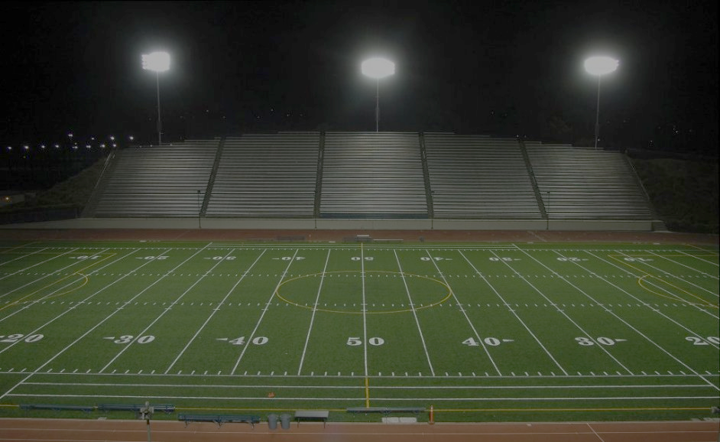
Definitions & Assumptions

Slide 6
Definitions & Assumptions:
Definitions
Assumptions
What is a Bye Week?
A week during the season a team does not play a game, giving the team extra time to prepare for the next opponent.
When quantifying a team’s performance, we looked at the following averages for games directly following a bye week vs. the rest of the season’s games:
Offensively – did the team score more points or total more offensive yards after a bye?
Defensively – did the team allow the opposing team to score less points after a bye?
We did not account for the following:
Coaching/roster turnover
Injuries
Level of competition
Weather

Slide 7
Coding Approach (High Level view)

Slide 8
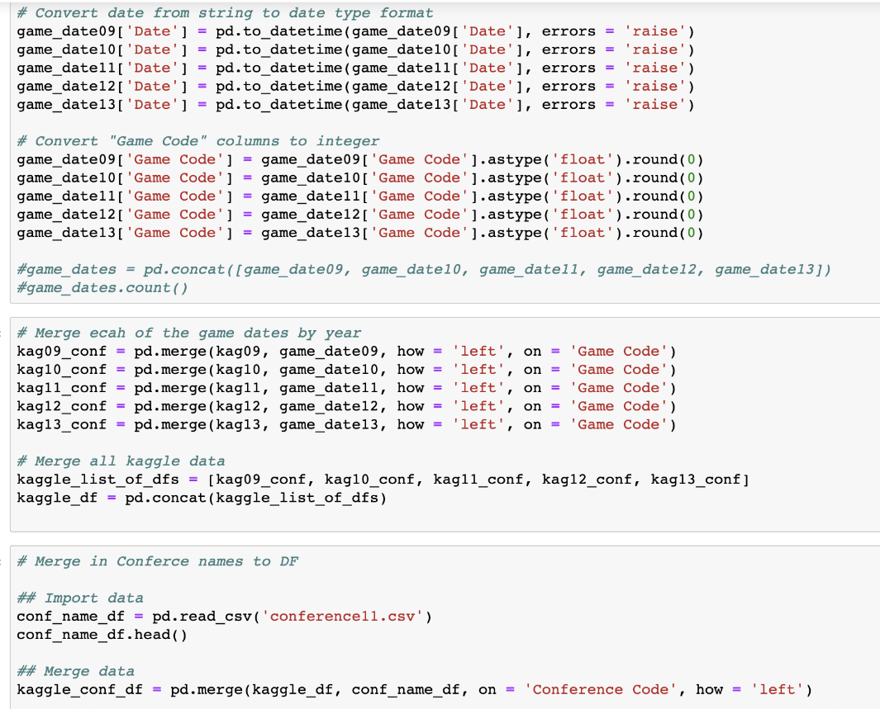
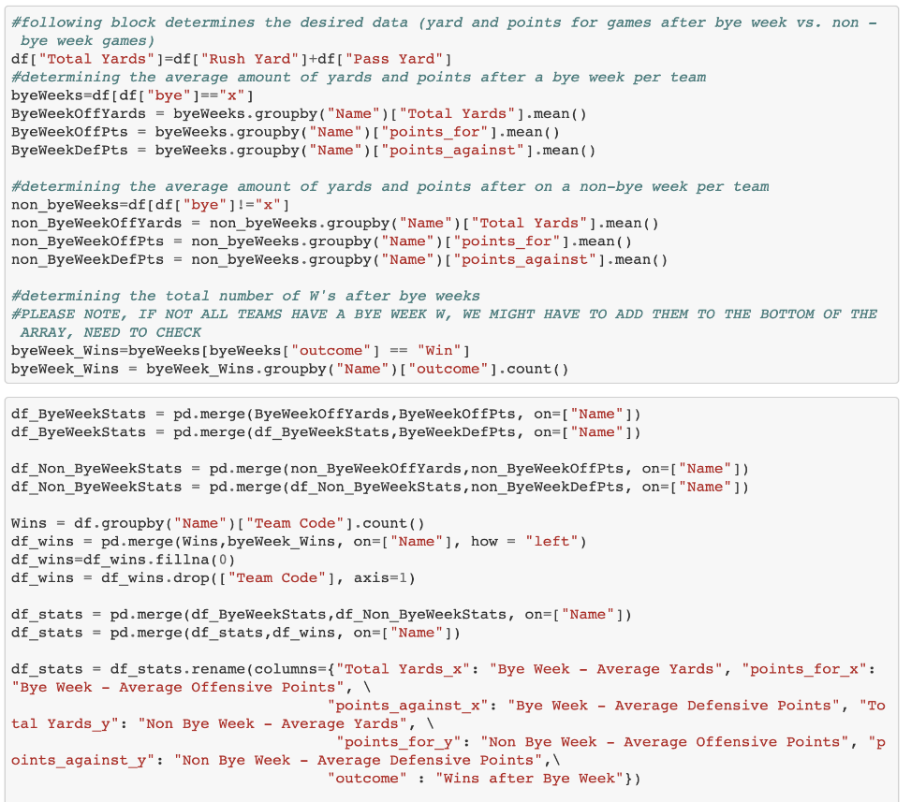
Coding Approach
Data Cleanup & Exploration
Analysis & Visualization
Data sources used for the project:
Kaggle (points scored, yardage totals, etc.)
CFB Stats (schedules)
Odd Shark (dates of bye weeks)
Python used to convert all sources to consistent dates, team names, and conferences
Used Pandas, Numpy, Matplotlib, and Scipy to analyze cleansed data
Generated relevant visualizations to communicate insights derived from the data

Slide 9
Question 1

Slide 10
Question 1A – Do Offenses Improve After a Bye?
(Are teams better after a bye week?)
1
Bar Graph: Average points per game for the given teams
Mean Score Evaluation: Bye weeks averages vs non-bye week average (team bars) & Comparison to population. Includes average across population.
2
3
Bottom Line: Teams on average score less following bye weeks than during other games
Average for Games Not After a Bye: 27.42
Game After Bye Week Average: 26.02

Slide 11
Question 1B – Do Offenses Improve After a Bye?
(Are teams better after a bye week?)
1
Bar Graph: Average total yards per game for the given teams
Mean Score Evaluation: Bye weeks averages vs non-bye week average (team bars) & Comparison to population. Includes average across population.
2
3
Bottom Line: Teams on average have less total yards following bye weeks than during other games
Average for Games Not After a Bye: 400
Game After Bye Week Average: 390

Slide 12
Question 2

Slide 13
Question 2 – Do Defenses Improve After a Bye?
(Are teams better after a bye week?)
1
Bar Graph: Average points per game allowed for the given teams
Mean Score Evaluation: Bye weeks averages vs non-bye week average (team bars) & Comparison to population. Includes average across population.
2
Bottom Line: Teams on average give up more points following bye weeks than during other games
3
Average for Games Not After a Bye: 23.16
Game After Bye Week Average: 24.62

Slide 14
Question 3

Slide 15
Question 3A – Which teams perform the best and worst after a bye?
Comparing offensive and defensive performance along with number of wins
1
(Are teams better after a bye week?)
(Are teams better after a bye week?)
1
2
2
(Are teams better after a bye week?)
(Are teams better after a bye week?)

Slide 16
Question 3A – Which conference has teams that perform the best and worst after a bye?
(Are teams better after a bye week?)
Box Plot: Quartile ranges of the average wins after a bye for the given teams
1
Quartile Evaluation: Wins within a conference after bye weeks compared to other conferences
ANOVA Test: statistic=0.608 && pvalue=0.659
2
Bottom Line: On average, Big 12 teams perform the best out of all conferences following a bye. The SEC teams perform the most consistently.
3

Slide 17

Perspective / Lessons Learned

Slide 18
References
1.) Kaggle
2.) CFB Stats
3.) Odd Shark

